Slide 1


Department of Computer Science and Engineering
Project Phase – II (18CSP83)
Review – 1
Art Gallery with E-Commerce (Artquarium.com)
Group No.: 1 Batch No.: 16
1KS18CS007 Avinash Prasad
1KS18CS028 Karthik K
1KS18CS029 Kavita Chaudhary
1KS18CS124 Shewani Chib
Guided By:
Mrs. Geetha R
Assistant Professor

Slide 2

Contents
Introduction
Comparison with similar work
Problem Statement and Objectives
Methodology Proposed/ Design
Technologies / Tools Used
Implementation of Modules with codes
Snapshots
References

Slide 3
Introduction
This project "Art Gallery with E-commerce" will be a platform where artist can not only share their artistic work but also, they can sell their masterpiece from the comfort of home, they can also view the traditional art and culture of each states of India.

Slide 4
Comparison with similar work
artQuarium
Artd'hope, Artsy
Support Artist : One can use social media to promote & E-commerce to buy and sell.
Promoting and supporting Indian art & culture.
Finding out nearby art shops.
Art Auctions will not be conducted.
India map with its art & culture.
Support Artist : By organizing events & enabling a platform to promote & offer their art of sale.
Promoting & supporting global art.
Finding out nearby art shops is not provided.
Art Auctions will be conducted.

Slide 5
Problem Statement
Due to Covid-19 local artist incurred losses in their work so they are:
Quitting their profession and are moving to secondary business
Not getting credit for their talent.
Which results in depletion of our Indian culture.

Slide 6
Objectives
Encouraging the growth of Indian art & culture on Digital platform.
Provides user-friendly environment.
Feasibility of making payment online itself to support Digital India Movement.

Slide 7
Methodology Proposed
Project Work Phase 1 | Project Work Phase 2
Zeroth Review : We did problem identification & requirement analysis which was described in project abstract.
First Review : We did detail study & planning based on problem scope and statement, we prepared a mockup design of our website.
We have started with the implementation of front-end and decided the technologies being used to integrate the whole front-end and back-end as single unit by following the SDLC (Software Development Life Cycle) process.

Slide 8
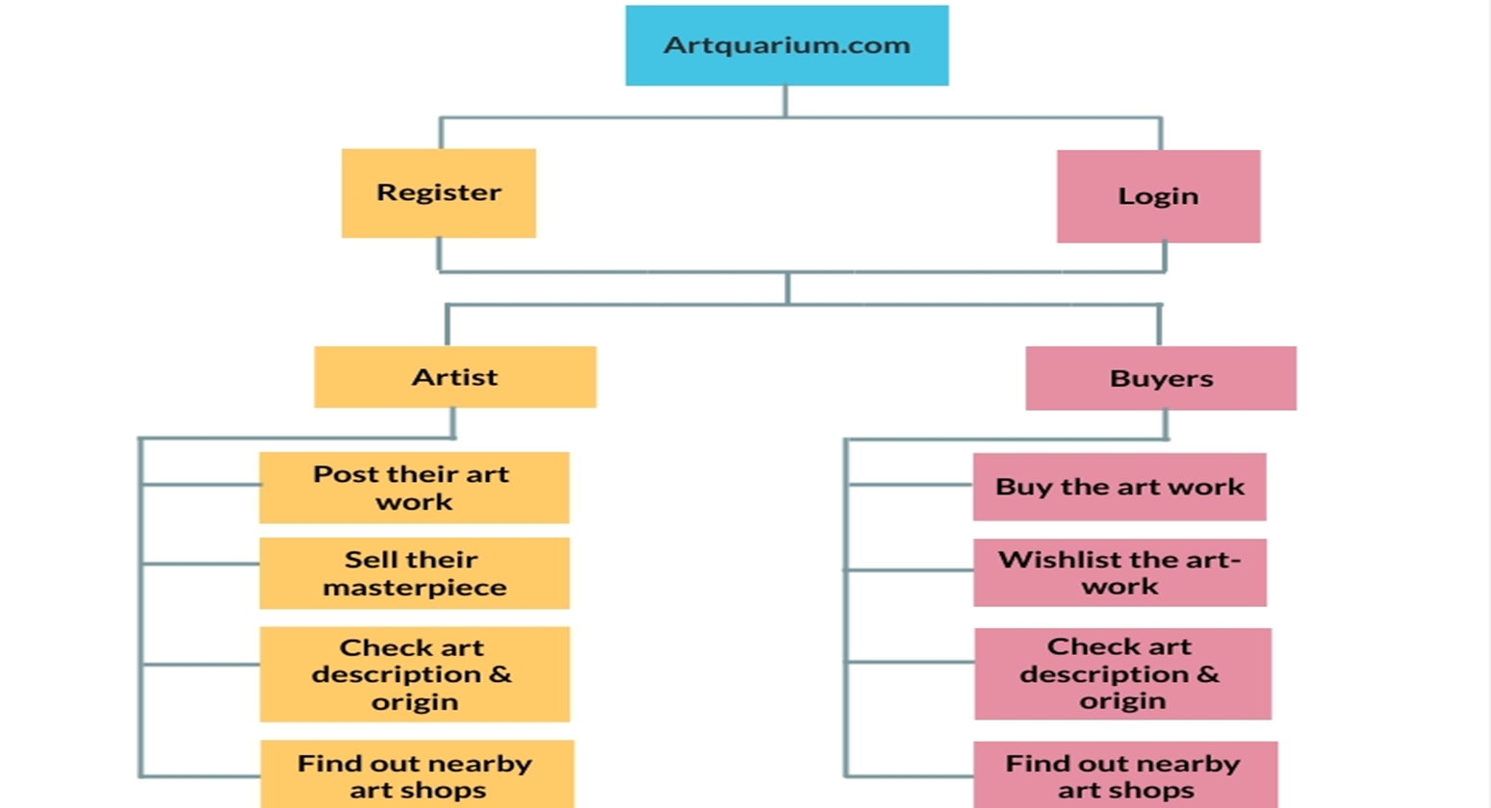
Block diagram of artQuarium

Slide 9
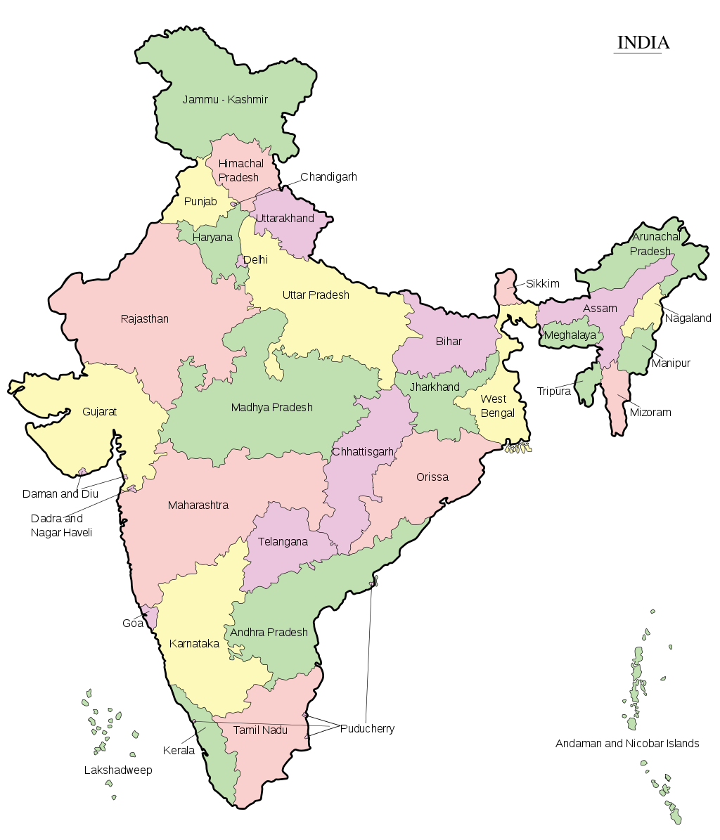
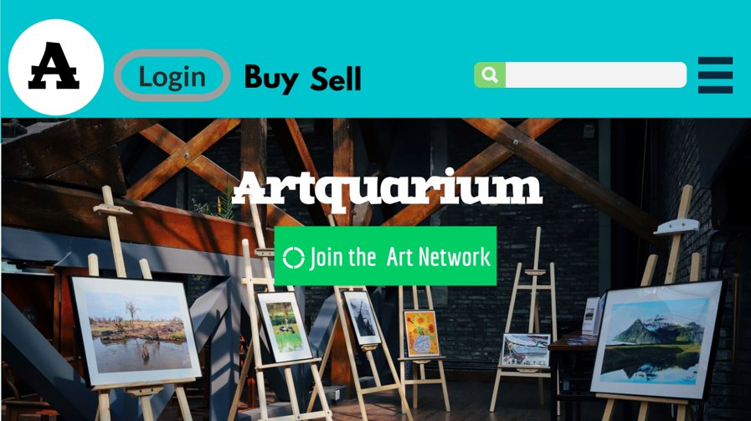
Design

Slide 10





Technologies/Tool used
Front-end : HTML, CSS, Bootstrap, JavaScript
Back-end : Django, MongoDB

Slide 11
Implementation of modules with codes
4 Modules are there:
India map with art & culture of each states.
Locating nearby art shops.
Implementing E-commerce part.
Connecting Users

Slide 12
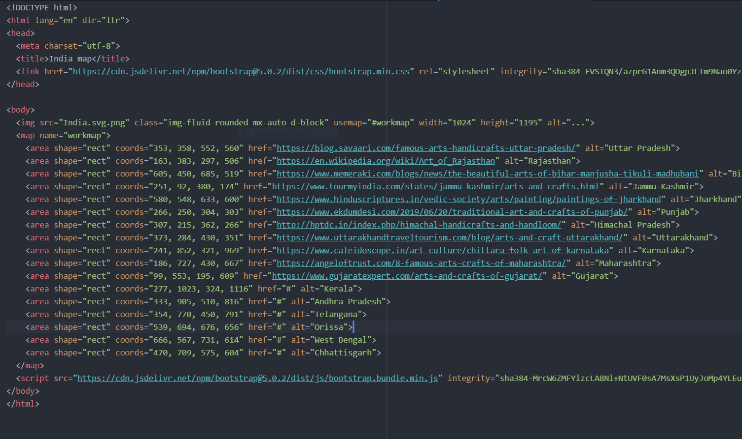
India map with art & culture of each states.

Slide 13
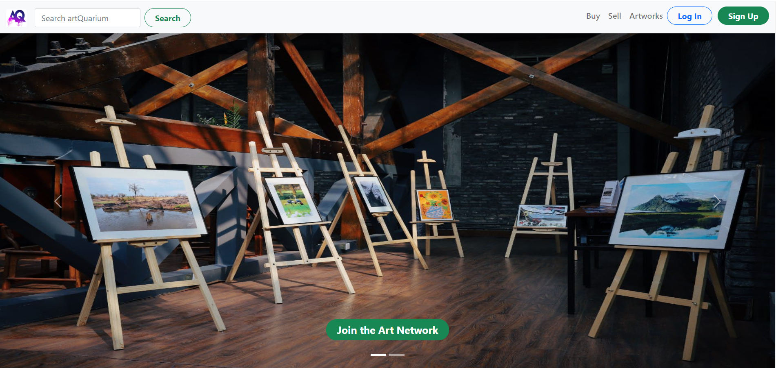
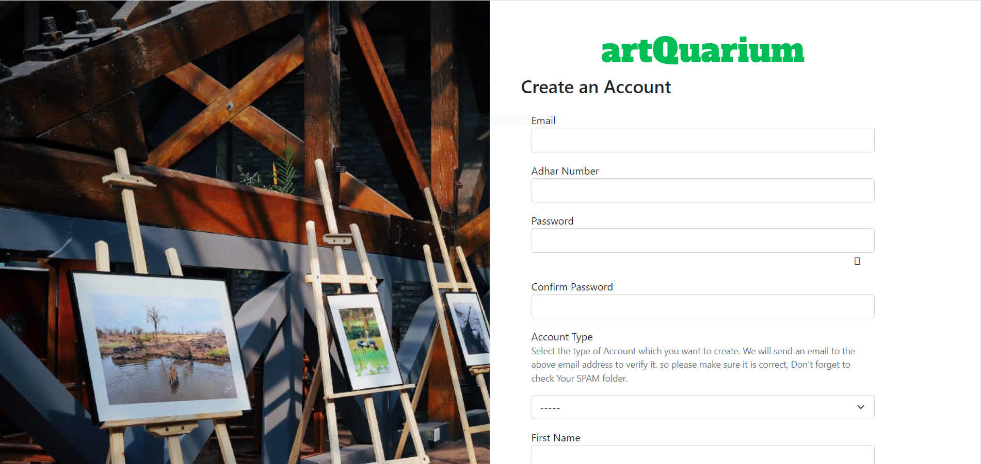
Snapshots

Slide 14
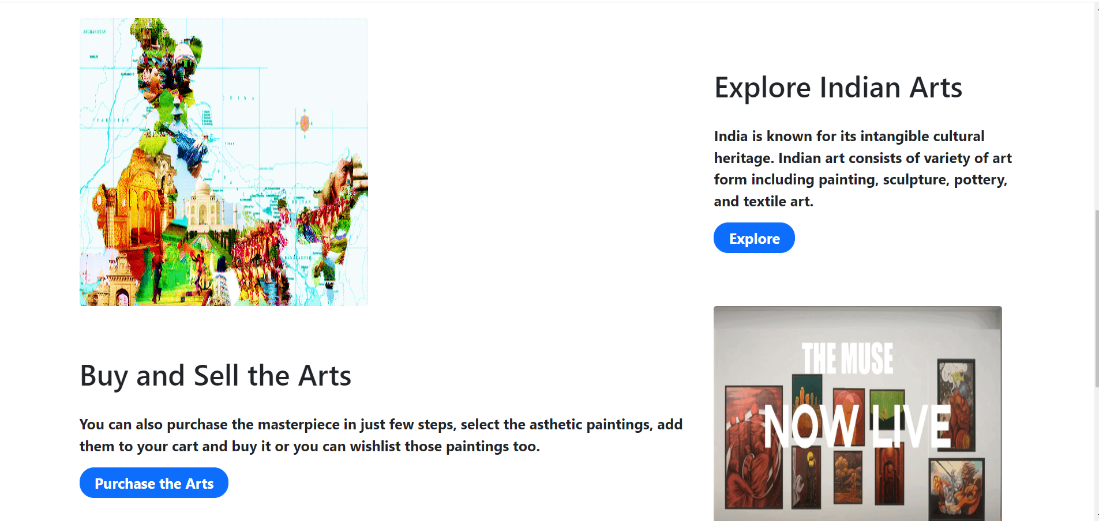
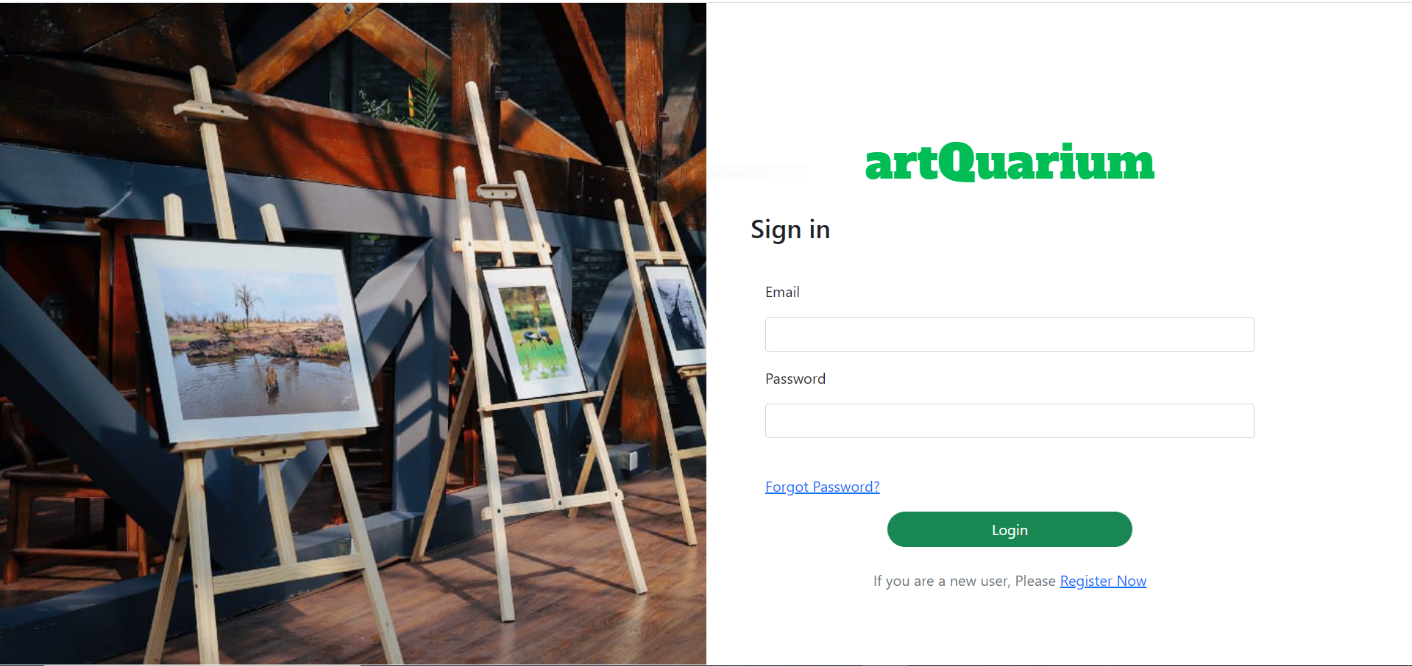
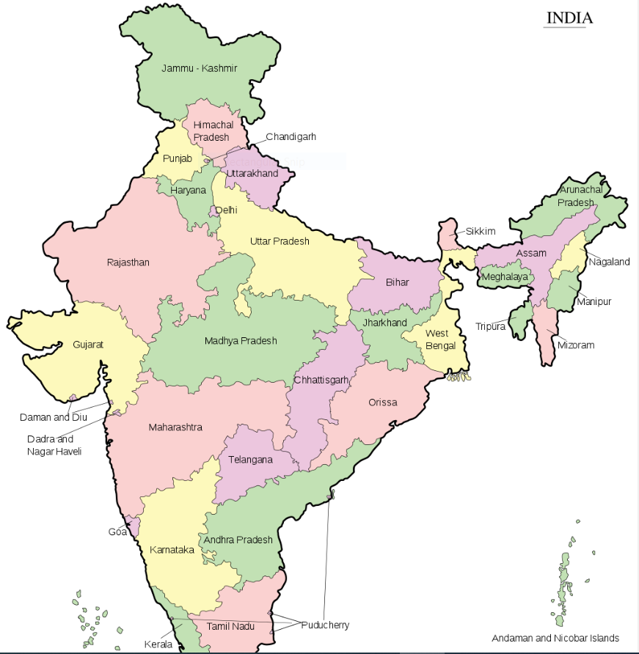
Snapshots

Slide 15
References
Journal Paper:
[1] Beatrix E.M. Habelsberger & Pawan V.Bhansing, Art Galleries in transformation: Is covid-19 driving digitisation, Multidisciplinary Digital Publishing Institute (MDPI), volume 10, Issue-3, July 2021.
[2] Xin Kang, Wenyin chen & Jian Kang, Art in age of social media : Interaction behavior analysis of Instagram art accounts, Multidisciplinary Digital Publishing Institute (MDPI), Volume 6, Issue-4, December 2019.
[3] Subham Vaid, Consumer and online payments, International Journal of Advanced Science & Technology, Volume 29, Issue-7, 2020.
Book :
"Fundamental of Web Development", Randy Connolly, Ricardo Hoar, 1st Edition, Pearson, published: 2015 .
Website :
For map work : https://www.w3schools.com/tags/tag_map.asp , 24/04/2022
For backend development : https://www.javatpoint.com/django-tutorial , 13/04/2022
How E-Commerce is reviving a lost Art : https://fedexbusinessinsights.com/how-e-commerce-is-reviving-a-lost-vietnamese-art/, 10/01/2022
How Artists on social media can grow : https://abj.artrepreneur.com/artists-on-social-media/ , 10/01/2022

